Slide 1
Surface Binding Energy Prediction using Machine Learning Models
Under Guidance of
Prof. S. Basu
Acknowledged by
Prof. Ali Haider
Dr. Tuhin Khan
By
Shivanshu Verma
2015CH70186
Notes:
Why Binding Energy?
Catalytic reaction cylce, adsorption, desorption, binding

Slide 2
Why Machine Learning ?
According to Sabatier Principle, binding energy is a good descriptor for catalytic activity.
Using DFT calculations to find adsorbate binding energies on the surface takes a lot of time and computation even on HPC.
Machine learning can predict the results based on previous results training in few minutes. More the data, more accurate the results.

Slide 3
Extracted Data
Filtered Data for Carbon
(88, 587 reactions)
Equation | Chemical Composition | Facet | Reaction Energy
0.5N2(g) + * -> N* | Sc3V9 | 111 | -2.810391181
0.5H2(g) + * -> H* | Pt9Ti3 | 111 | -0.292809865
CH4(g) - 2.0H2(g) + * -> C* | Ag6Pd6 | 211 | 4.541566089
Equation | Chemical Composition | Facet | Reaction Energy
CH4(g) + 5* -> C* + 4H* | Au3Cu | 111 | 5.805189557
CH4(g) + 5* -> C* + 4H* | Au3Pb | 111 | 5.419068456
CH4(g) + 5* -> C* + 4H* | Au3Pd | 111 | 4.925831102
High-throughput Calculations Of Catalytic Properties Of Bimetallic Alloy Surfaces". Mamun, Osman; Winther, Kirsten T.; Boes, Jacob R.; Bligaard, Thomas. Scientific Data. 6, 76 (2019)

Slide 4
AIM
Feature Vector [ AN, AM, group, period, radius, EN, MP, BP, H_FUS, density, IE, SE, same for second atom ]
To predict carbon binding energy on 111 surfaces using catalyst atoms’ properties as feature vector.
Linear Regression
K nearest neighbours
Support Vector Regressor
Gradient Boosting Regressor
INPUT
OUTPUT
PHYSICAL PROPERTIES
SURFACE BINDING ENERGY
MACHINE LEARNING MODELS

Slide 5
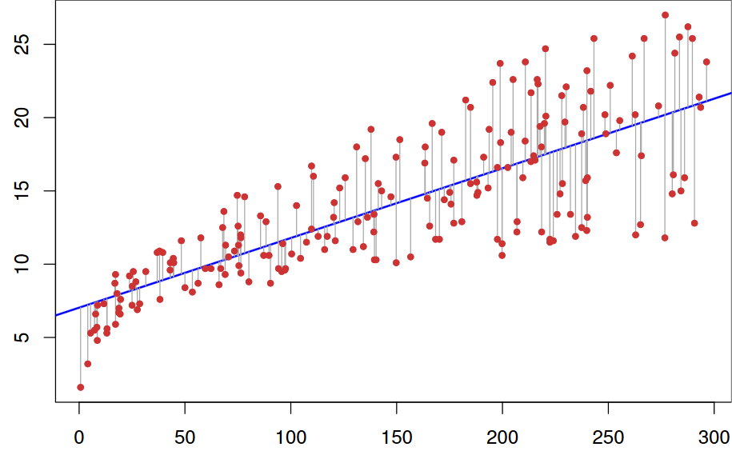
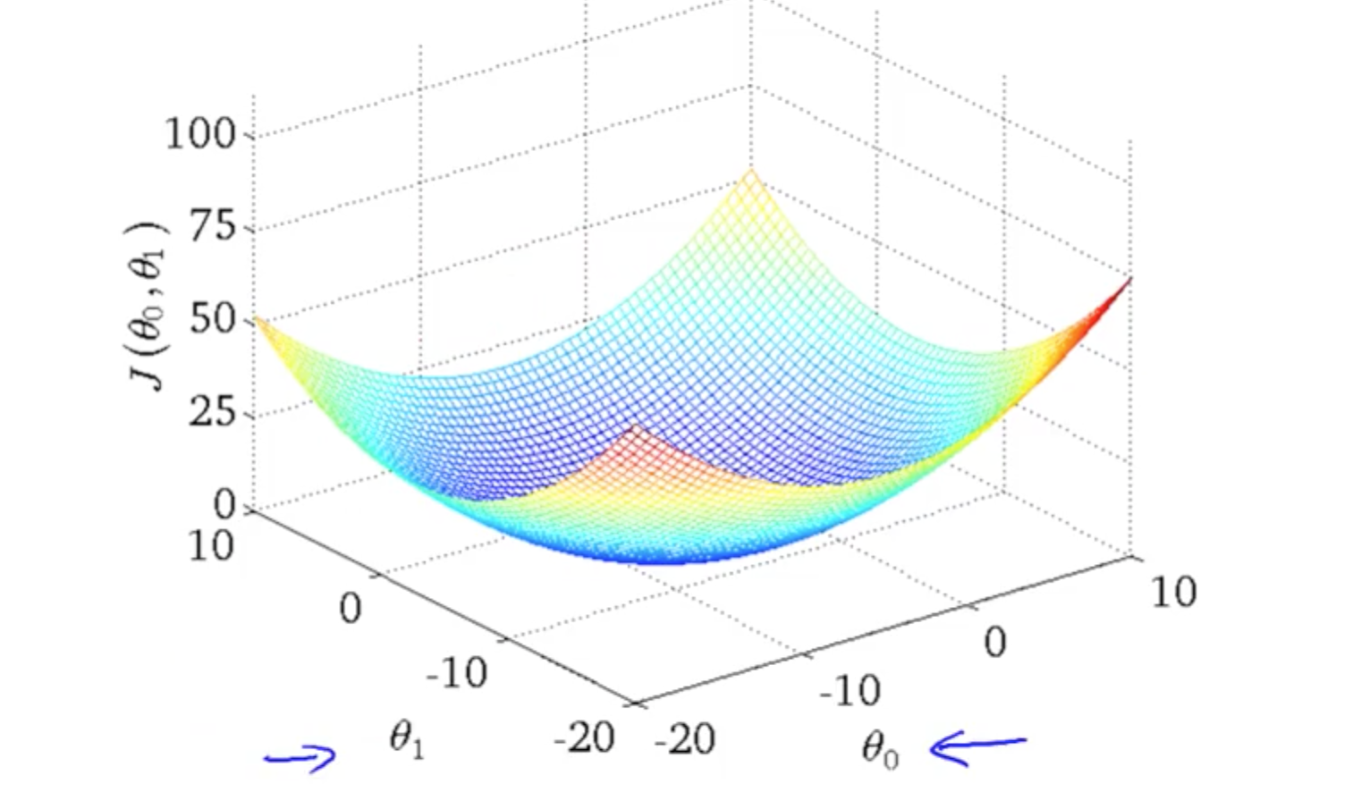
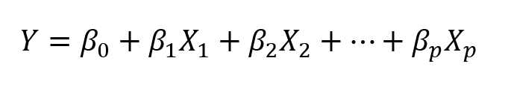
Linear Regression
Gradient Descent Algorithm
https://www.simplilearn.com/regression-machine-learning-tutorial

Slide 6
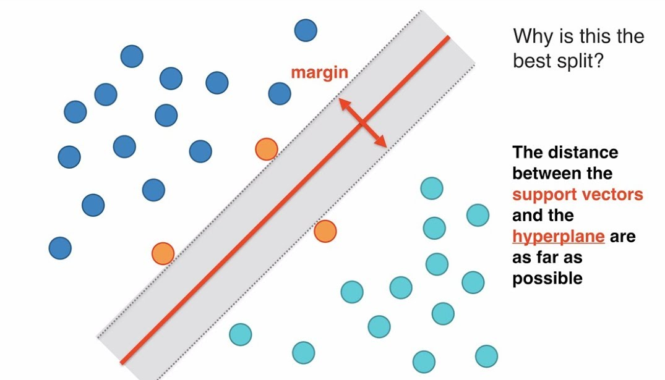
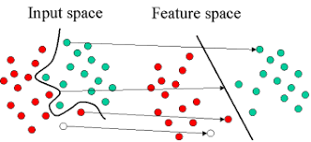
Support Vector Regression
Support Vectors
Kernels
Optimized with a set of
[Rbf, poly, linear, sigmoid] kernels
http://www.statsoft.com/textbook/support-vector-machines

Slide 7
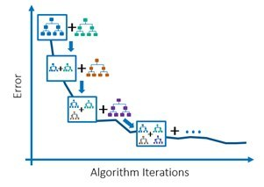
Gradient Boosting KNN Regressor
Gradient boosting adds sub-models incrementally to minimize a loss function
http://www.cse.chalmers.se/~richajo/dit866/lectures/l8/gb_explainer.pdf

Slide 8
Comparison b/w Models

Slide 9
Comparison b/w Models

Slide 10
Comparison b/w Models

Slide 11
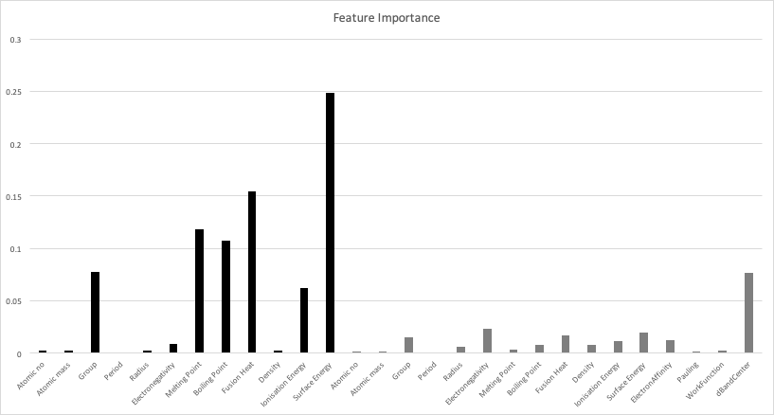
Feature Importance for Carbon

Slide 12
Filtered Data for Oxygen
(3,683 reactions)
Equation | Chemical Composition | Facet | Reaction Energy
H2O(g) - H2(g) + * -> O* | Cr9Sn3 | 111 | -0.1206
H2O(g) - H2(g) + * -> O* | W9Zr3 | 111 | -1.4925
H2O(g) - H2(g) + * -> O* | Cd9Pd3 | 111 | 2.9345
Further Filtration
Reaction Basis
Bimetallic
Negative Binding Energy
(3,683 reactions)
(2,881 reactions)
(1,609 reactions)
High-throughput Calculations Of Catalytic Properties Of Bimetallic Alloy Surfaces". Mamun, Osman; Winther, Kirsten T.; Boes, Jacob R.; Bligaard, Thomas. Scientific Data. 6, 76 (2019)
Notes:
Created Features using python script.

Slide 13
Feature Creation for Oxygen Data
Cr9Sn3
Cr
Sn
Periodic Properties
Periodic properties
A python script breaks Cr9Sn3 into Cr, Sn and 3. Searches Cr and Sn properties from dictionary and merge them to form final feature vector.
Created a python dictionary with key as Element name and value as its periodic properties
Ratio : 3
Note : Electron Affinity, d band centre and work functions were not included here.
24 Features Input Vector

Slide 14
Comparison b/w Models

Slide 15
Comparison b/w Models

Slide 16
Comparison b/w Models

Slide 17
THANK YOU

